Slide 1

Expert UX review of ebay
Jesper Fischer Ehmsen (201910213)
Date: 12/07/2023

Slide 2
Introduction
Here I make an expert user experience (UX) review of the e-commerce website https://www.ebay.com/ and a possible usability test plan, which could help elucidate potential issues in UX. In this report I present seven potential UX issues in the following structure:
Predicted issues: Here, I will show and explain what might cause issues for UX.
Root causes: Here, I will explain why one could assume that the design might cause UX issues from a cognitive science perspective and list references for future investigation.
Recommendations: Here, I will show and explain how one could update the design to alleviate these potential issues.
After presenting the seven potential issues, I will show a design strength that the website is already leveraging and then lastly the possible usability test plan.

Slide 3
Potential problems in the current design

Slide 4
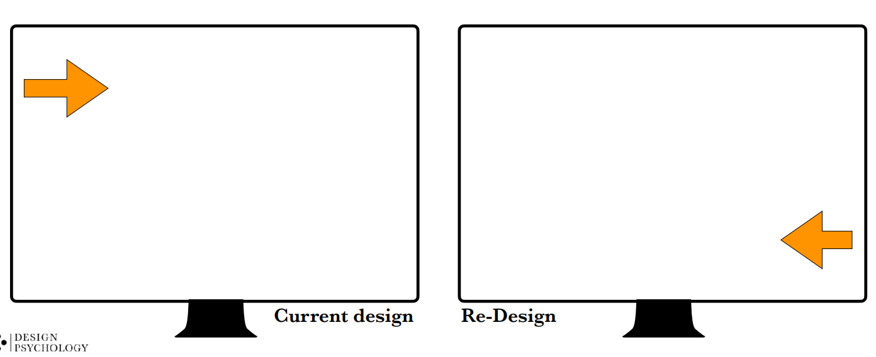
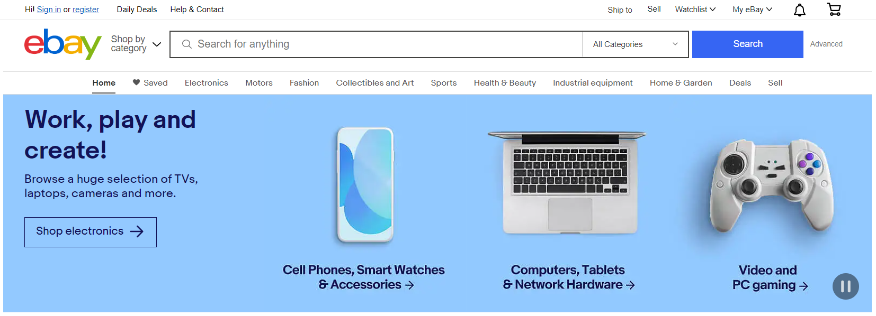

Issue 1: Problem Description.
Predicted issue: Overlooked functionalities.
Visual Hierarchy.
Due to the very little contrast between functionalities in the upper menu, these might be overlooked.
Root cause of issue.
Peripheral and foveal vision.
Our visual system only has a very limited range where objects are easily distinguished, especially if there is no clear contrast between [1]. Making the image blurred, gives an indication to which elements in the visual hierarchy might overlap.
Current design.

Slide 5

Issue 1: Problem Description (blurred vision test).
Predicted issue: Overlooked functionalities.
Visual Hierarchy.
Due to the very little contrast between functionalities in the upper menu, these might be overlooked.
Root cause of issue.
Peripheral and foveal vision.
Our visual system only has a very limited range where objects are easily distinguished, especially if there is no clear contrast between [1]. Making the image blurred, gives an indication to which elements in the visual hierarchy might overlap.
Current design.

Slide 6


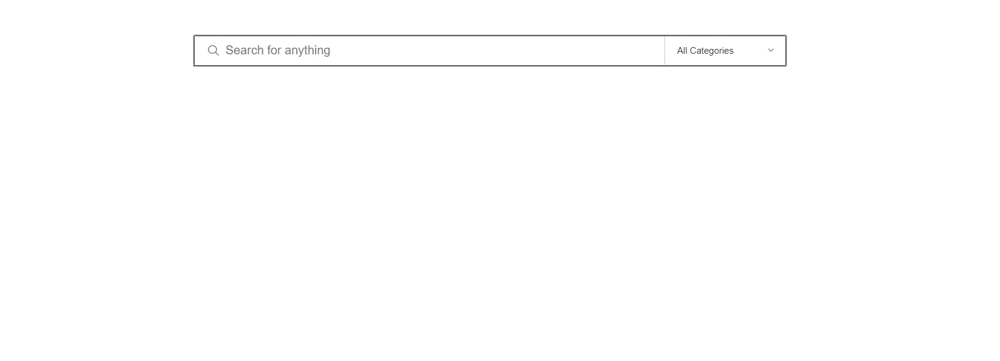

Issue 1: Recommendations.
Recommendations to help navigate the front page.
Add visual contrast to help distinguish the upper panel from the search menu and the lower panel.
Adding a contrasting layer on top of the search bar creates a clear visual distinction between the top panel, the search bar and the search category section. This might help users clearly distinguishing these different features.
Shop by category
advanced
Re-design.

Slide 7
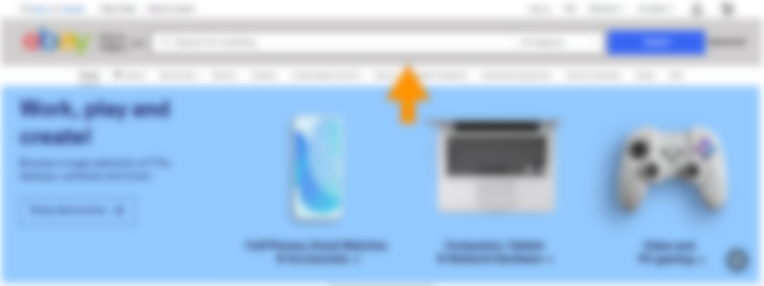
Issue 1: Recommendations (blurred vision test).
Recommendations to help navigate the front page.
Add visual contrast to help distinguish the upper panel from the search menu and the lower panel.
Adding a contrasting layer on top of the search bar creates a clear visual distinction between the top panel, the search bar and the search category section. This might help users clearly distinguishing these different features.
Shop by category
advanced
Re-design.

Slide 8
Issue 2: Problem Description.
Predicted issue: Overlooked functionalities.
Visual Hierarchy, consistency and proximity.
Due to the inconsistency in how buttons, drop-down menus and clickable links are displayed, users might not realize that certain objects have certain functionalities
Standards and knowledge transfer.
Users are used to icons in the upper panel and might therefore just scan this section and not read the actual labels, hereby missing their functionality.
Root cause of issue.
Internal and external standards.
Users come with preconceived notions of what is clickable but will also learn what is clickable from interacting with the website. Being consistent in the design is therefore crucial to guide the user experience. [3]
Peripheral and foveal vision.
In the peripheral vision or when scanning the site, objects are generally easier to discover compared to text. [1, 2]
Current design.

Slide 9
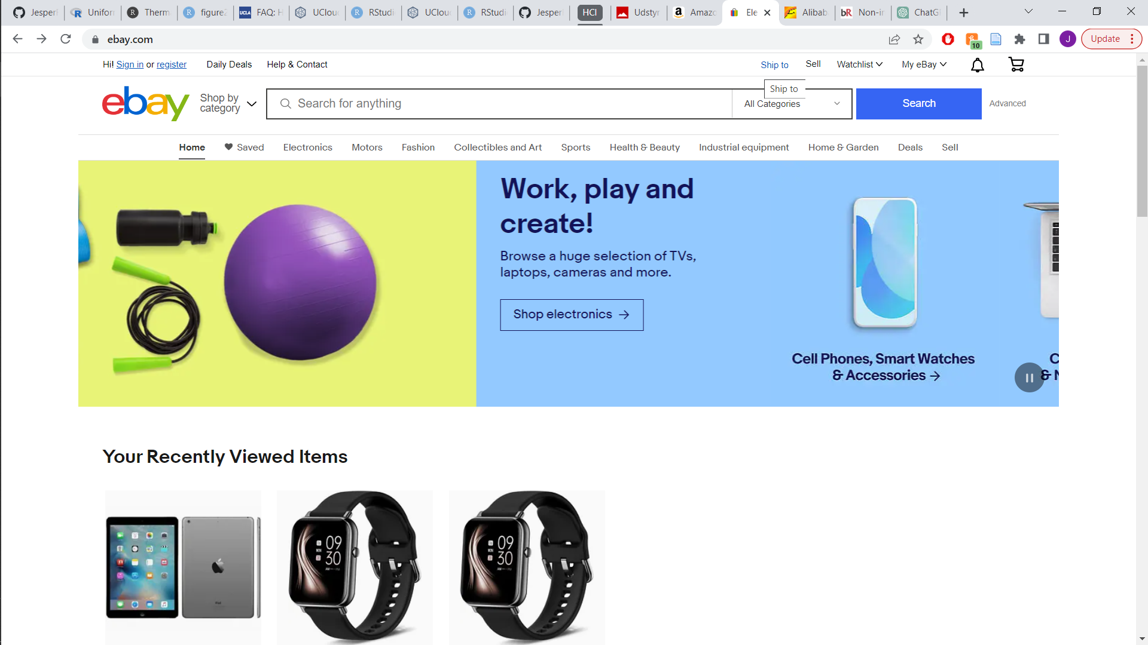
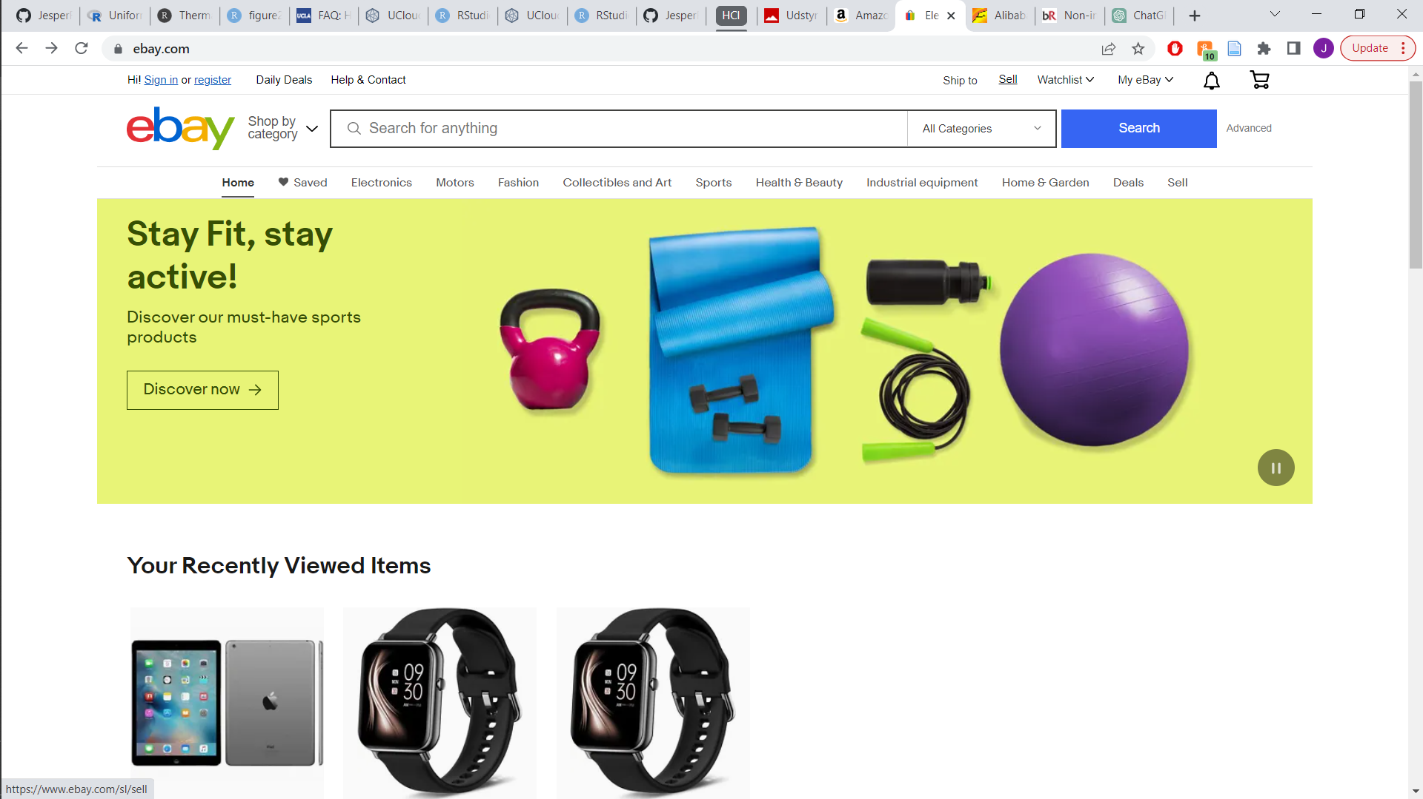
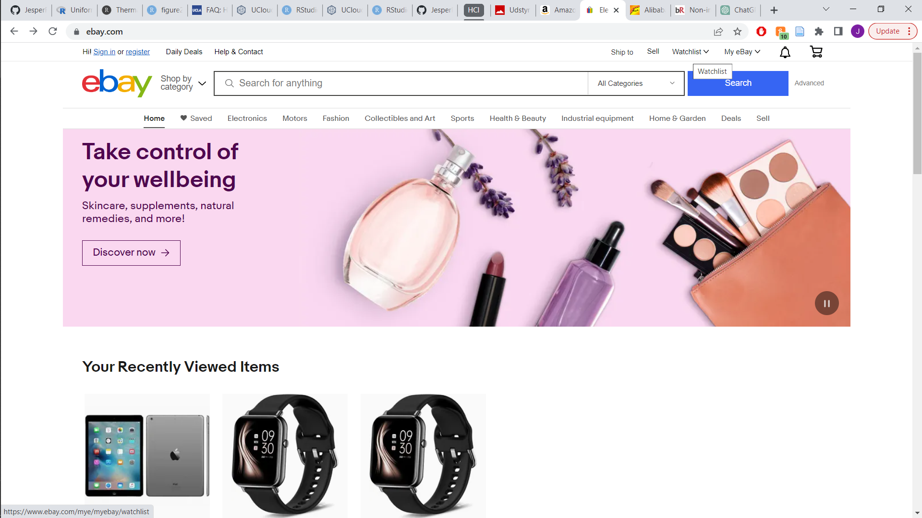

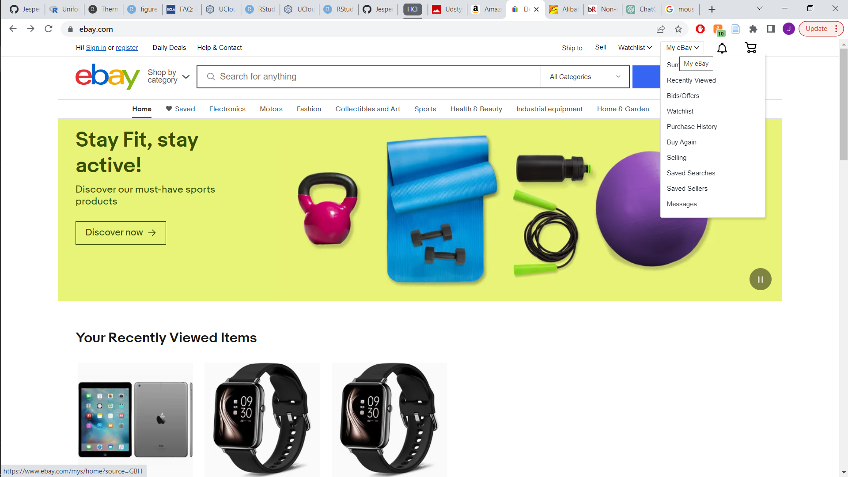
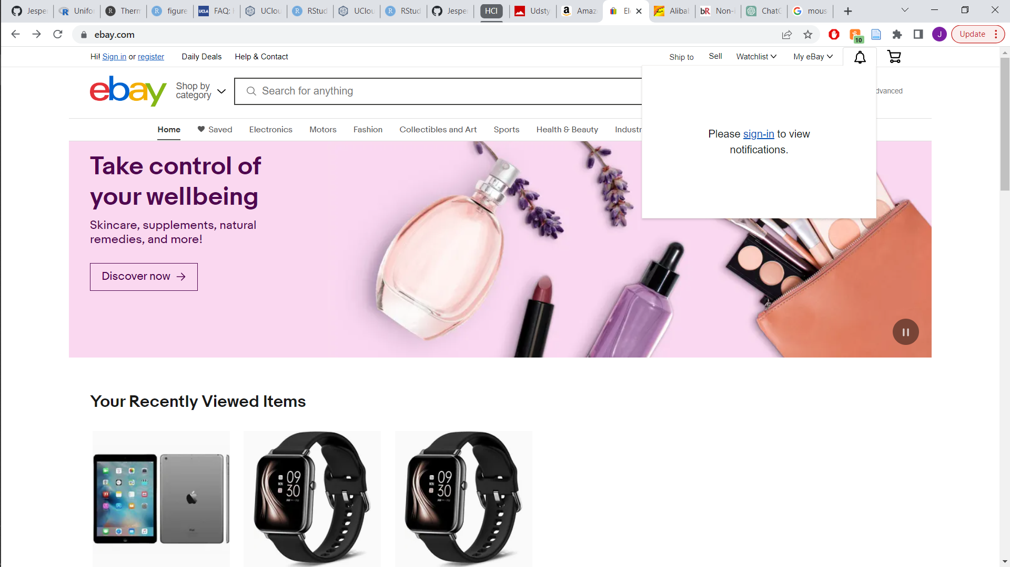
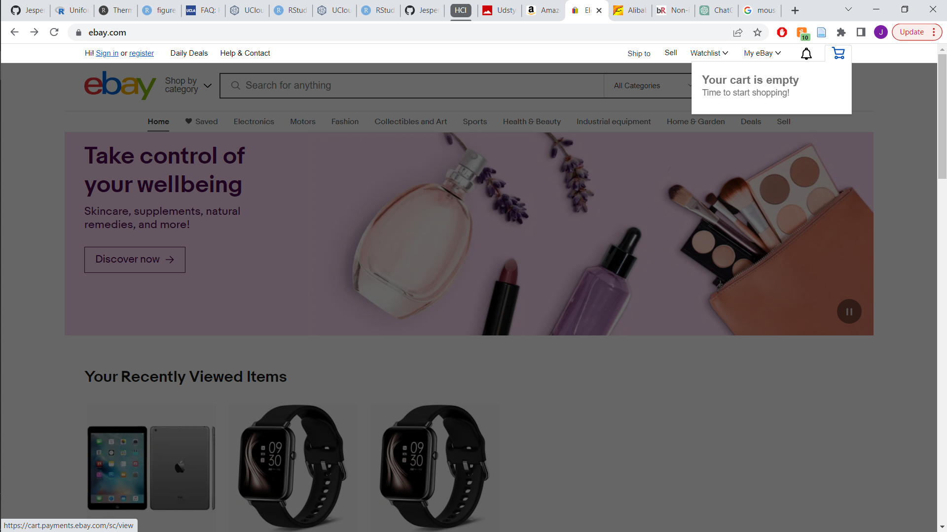
Issue 2: Problem Description (consistency example).
Current design.

Slide 10



Issue 2: Recommendations.
Recommendations to facilitate and make functionalities of objects obvious.
Leveraging industry standards of icons and buttons.
Using the already implemented internal standard that drop-down menus have a small arrow next to them, will help users knowing the functionalities without having to click or hover their mouse.
The use of icons are valuable, as these reduce the need for reading and are most often easier to detect.
Sell
Ship to:
Re-design.

Slide 11
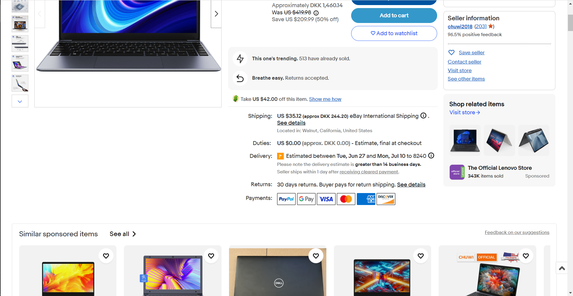
Issue 3: Problem Description.
Predicted issue: Information placement.
Visual Hierarchy and consistency.
This page includes a lot of text which is hard to distinguish. This could confuse and make the user have trouble finding the information they are searching for.
Proximity.
Similar products to the product being looked at, are presented before the actual specifications of the product itself.
Root cause of issue.
Reading in relation to cognitive effort.
Having a lot of text on a page that is not easily distinguished and organized will increase the possibility of users not being able to find the desired function or at least require more effort from the user. [2]
Visual design, proximity.
We will generally look for related objects in proximity to the object at hand [4]. Therefore, placing the product specifications close to the object can help users find this crucial information.
Current design.

Slide 12
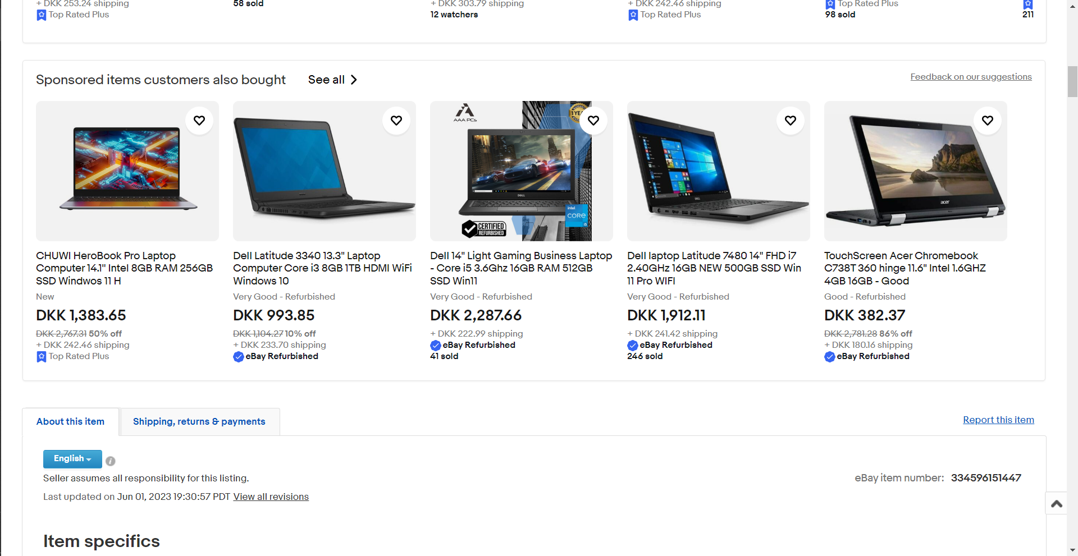
Issue 3: Problem Description further example.
Predicted issue: Information placement.
Visual Hierarchy and consistency.
This page includes a lot of text which is hard to distinguish. This could confuse and make the user have trouble finding the information they are searching for.
Proximity.
Similar products to the product being looked at, are presented before the actual specifications of the product itself.
Root cause of issue.
Reading in relation to cognitive effort.
Having a lot of text on a page that is not easily distinguished and organized will increase the possibility of users not being able to find the desired function or at least require more effort from the user. [2]
Visual design, proximity.
We will generally look for related objects in proximity to the object at hand [4]. Therefore, placing the product specifications close to the object can help users find this crucial information.
Current design.
Current design

Slide 13
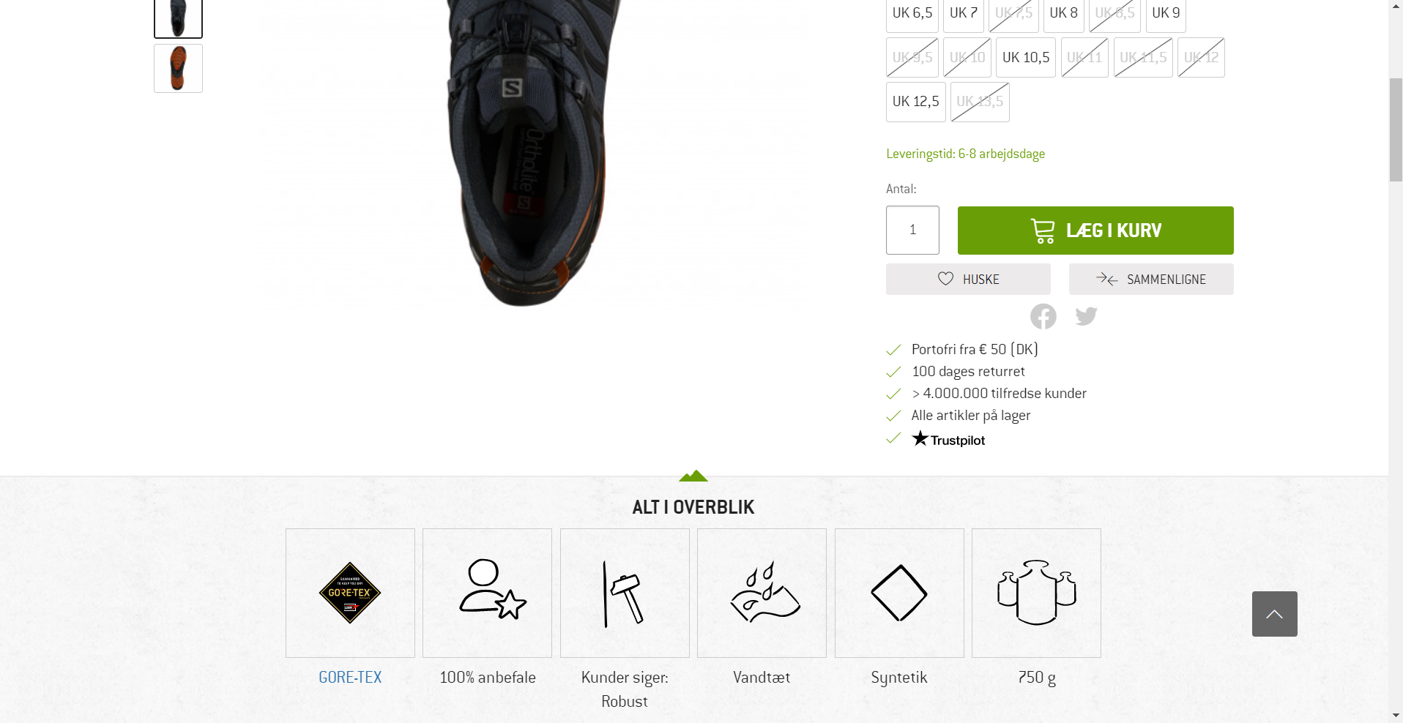
Issue 3: Bergfreunde example.

Slide 14
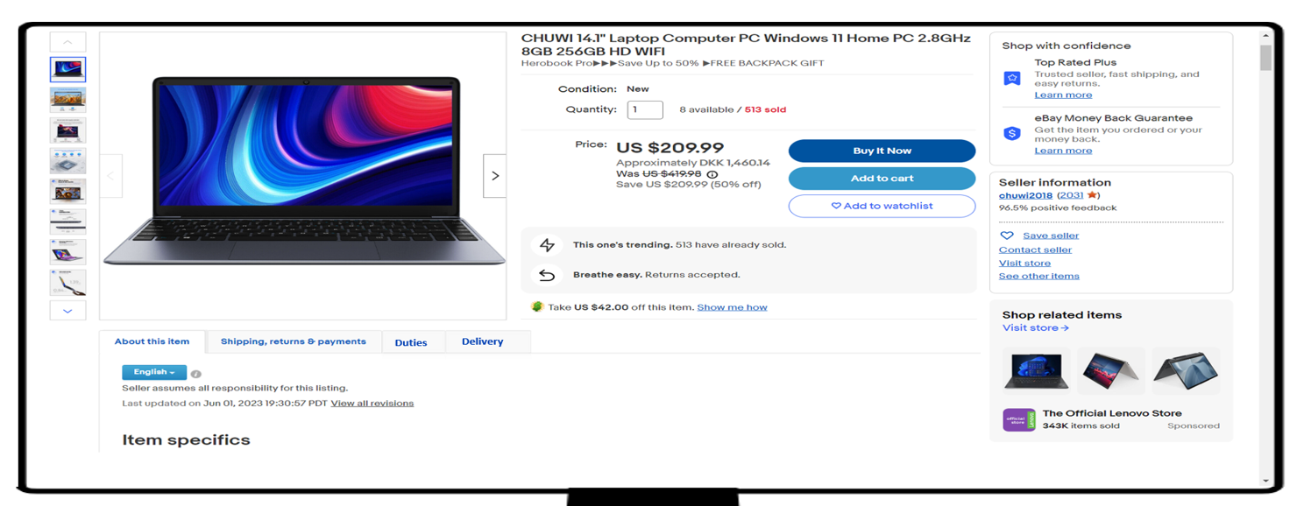
Issue 3: Recommendations.
Recommendations to utilize industry standards and proximity.
Industry standards and proximity.
Add the section about the item, shipping and other information close to the item, as users will expect aspects related to the item in proximity.
Changing the location of the text with information of duties, delivery etc. to the section about the item. This can help with the visual hierarchy i.e., making users look at the most important aspects, while still being able to access the information.
Re-design.

Slide 15
Issue 4: Problem Description.
Predicted issue: selling items.
Core functionalities being hidden.
Due to the quite unique functionality of being able to sell products on ebay, this should be more easily noticeable, as its very well hidden.
Root cause of issue.
Visibility and proximity.
It can be challenging to notice the possibility of selling items, as this option is hidden among buying options. The visual system tends to group things based on proximity, making the selling option less noticeable.[4]
Current design
Current design.

Slide 16

Issue 4: Recommendations.
Recommendations to help the user find the sell option.
Add visual contrasts and establish an internal standard.
By adding a contrasting element to the sell options, the option of selling will become more obvious and less likely to be grouped with the buying options.
Furthermore, adding an internal standard to the design, makes the communication of selling items easier in other sites on ebay.
Sell
Sell
sell electronics
Current design
Re-design.

Slide 17
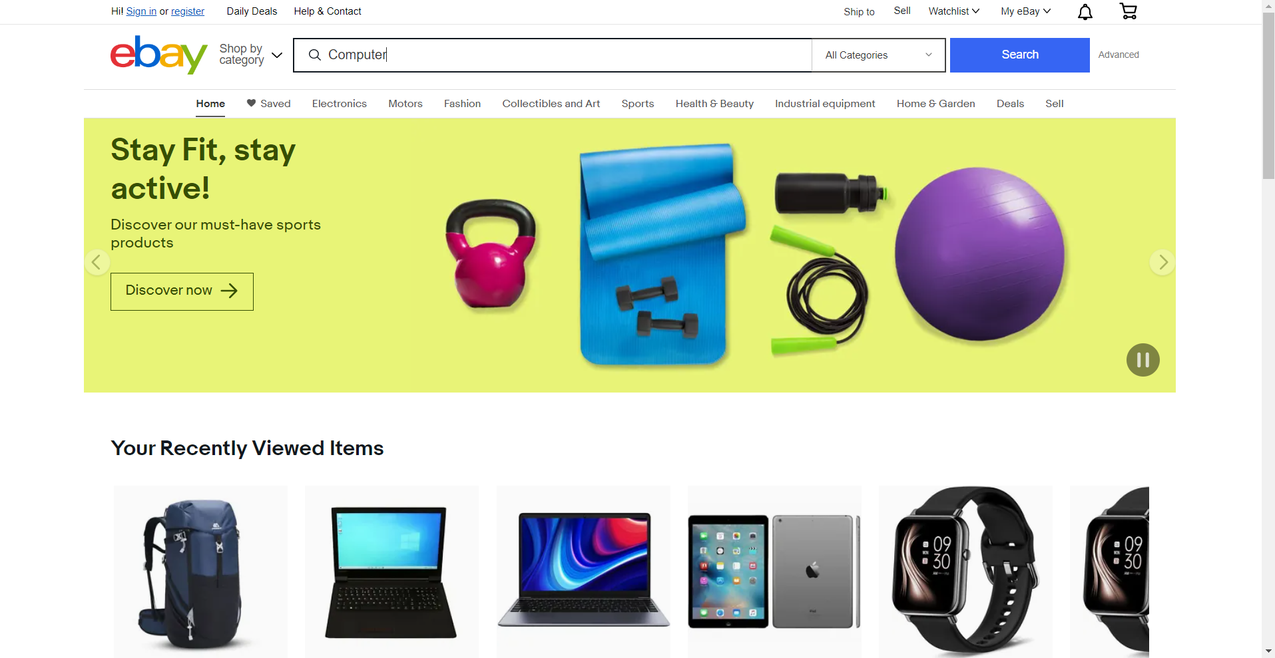
Issue 5: Problem Description.
Predicted issue: searching.
Autofill.
There is no auto completion or pop up for the search function. This puts more effort on the user than is necessary, requiring them to type the whole search word as well as spelling correctly.
Root cause of issue.
Adhere to standards.
Users will be used to a search function that will give a pop-up with suggestions for auto-completion. Not having this function will unnecessarily increase the amount of work and attention the user must spend to get to the desired page. [5,6]
Current design.

Slide 18
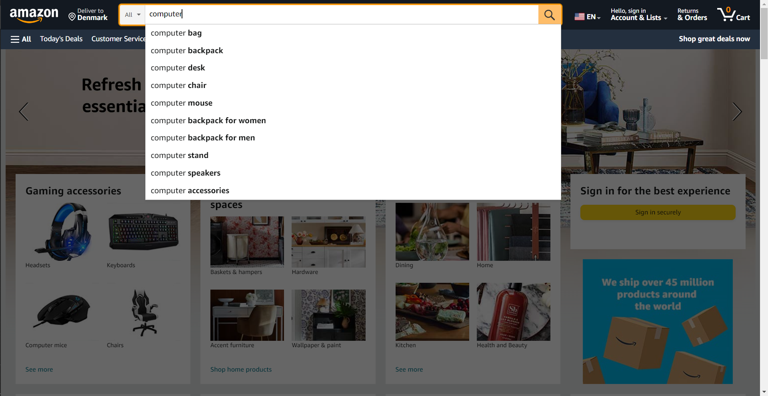
Issue 5: Amazon example.

Slide 19
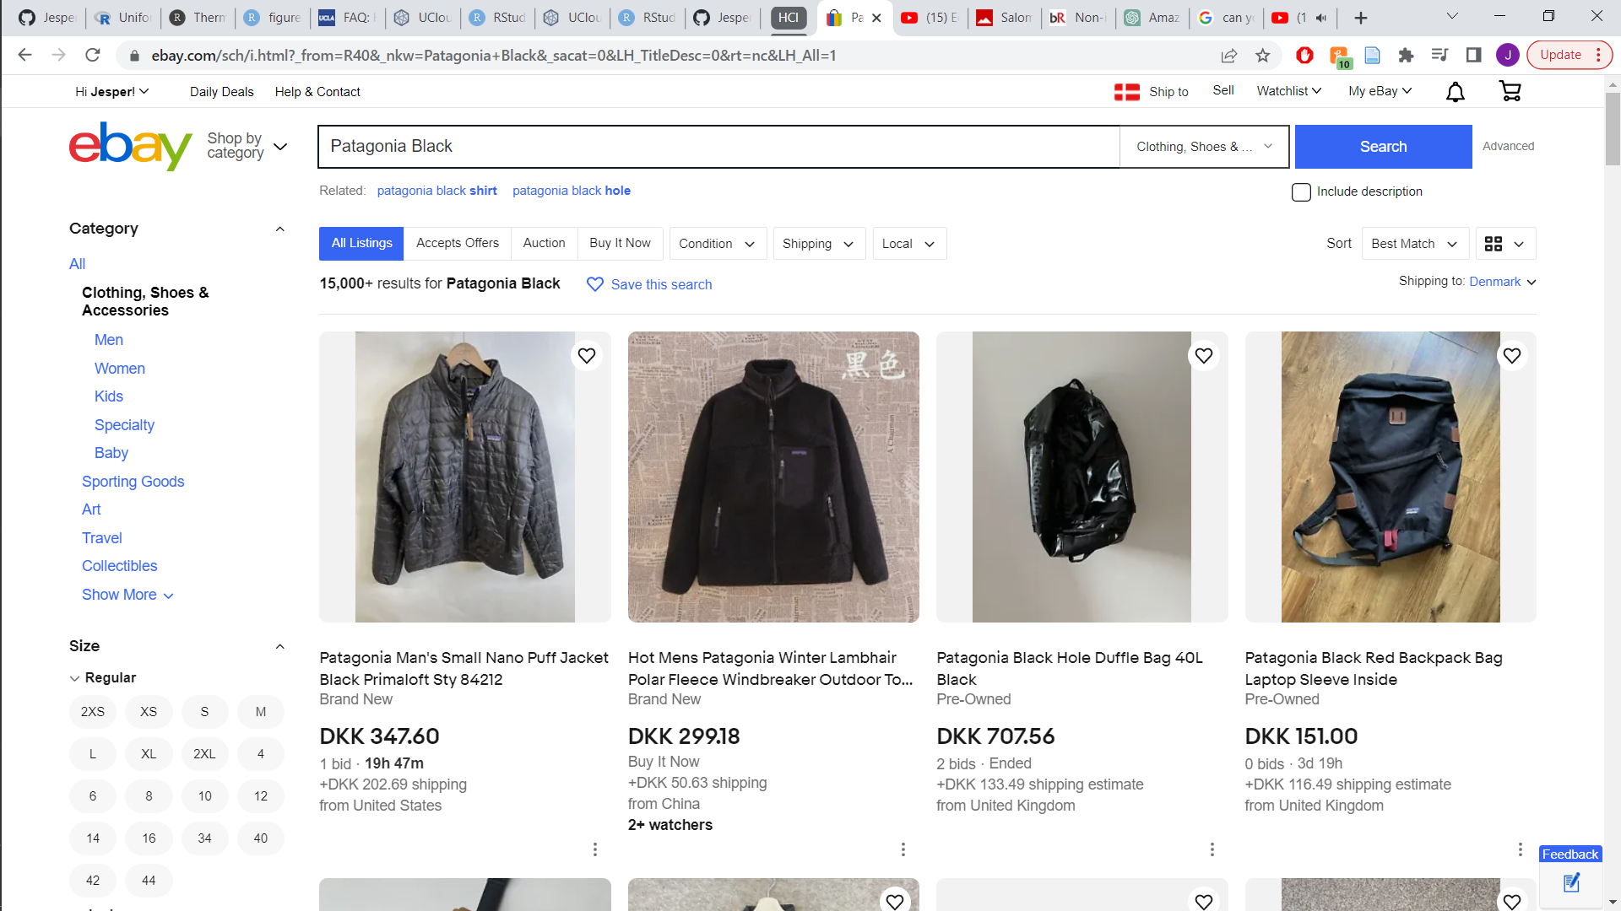
Issue 6: Problem Description.
Predicted issue: Bid or buy.
Core functionalities being hidden.
There are a couple of different ways of buying items on ebay, including buying now and bidding on an item. New users to ebay, not knowing of the bidding functionality, might be confused about this as it is not something that is clearly presented on the items or on other pages on ebay.
Root cause of issue.
Visibility.
Poor visibility of the purchase nature of items, could increase the probability of users accidentally going into an item that is “bidding” when wanting an item they can buy now or vice versa. [2]
Current design.

Slide 20
Issue 6: Recommendations.
Recommendations to increase visibility of purchase options.
Add contrasting element in proximity to product.
In order to reduce potential confusion between products that are available for immediate purchase and those only accessible through auctions, incorporating a contrasting element either in the product picture or in the accompanying text could be beneficial as that could draw the visual attention.
Bids only
Bids only
Bids only
Bids only
Bids only
Re-design.

Slide 21
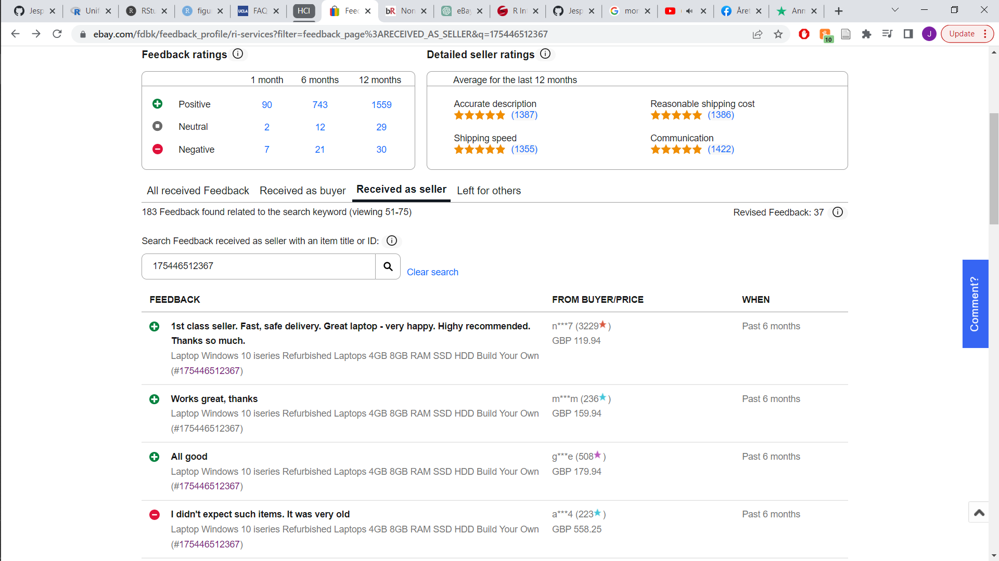
Issue 7: Problem Description.
Predicted issue: Feedback profile.
Standards.
By not adhering to standards, users might find the icons presented to be clickable, and thereby displaying more information.
Complexity.
Reducing redundant and even removing information that is not useful for the user, will help the user more easily scan the text of the reviews.
Root cause of issue.
Adhere to standards.
By adhering to standards, one will avoid the issue of potential confused users about the functionality of the icons. [3]
Scanning text.
When users enter a website, they seldomly start reading, they will usually scan the site without careful reading, therefore reducing text is preferable. [2,7,8]
Current design
Current design
Current design.

Slide 22
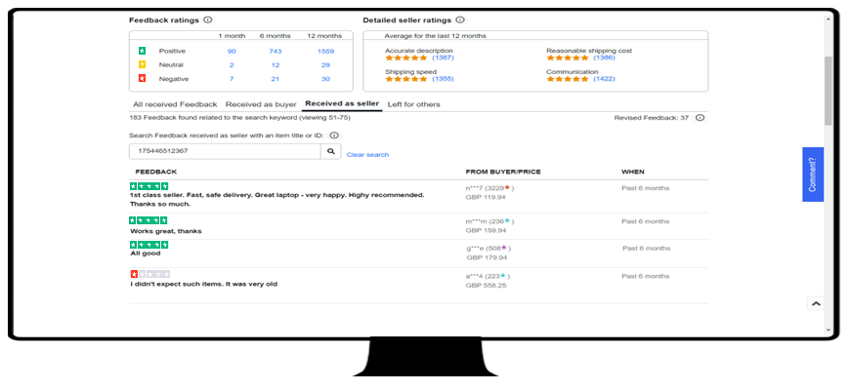
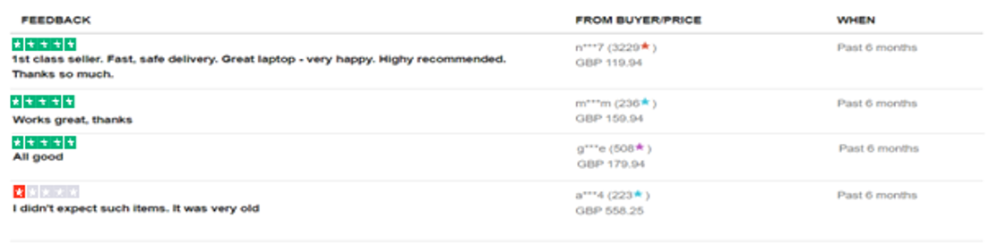
Issue 7: Recommendations.
Recommendations to reduce confusion and complexity.
Removing ambiguous icons and redundant text.
By using stars as icons which are already standard on other web applications, as well as on the site itself, one might avoid confusion by focusing on making the design more intuitive.
By removing redundant and complex the information, the text is more easily scannable.
Re-design.

Slide 23
Strength

Slide 24
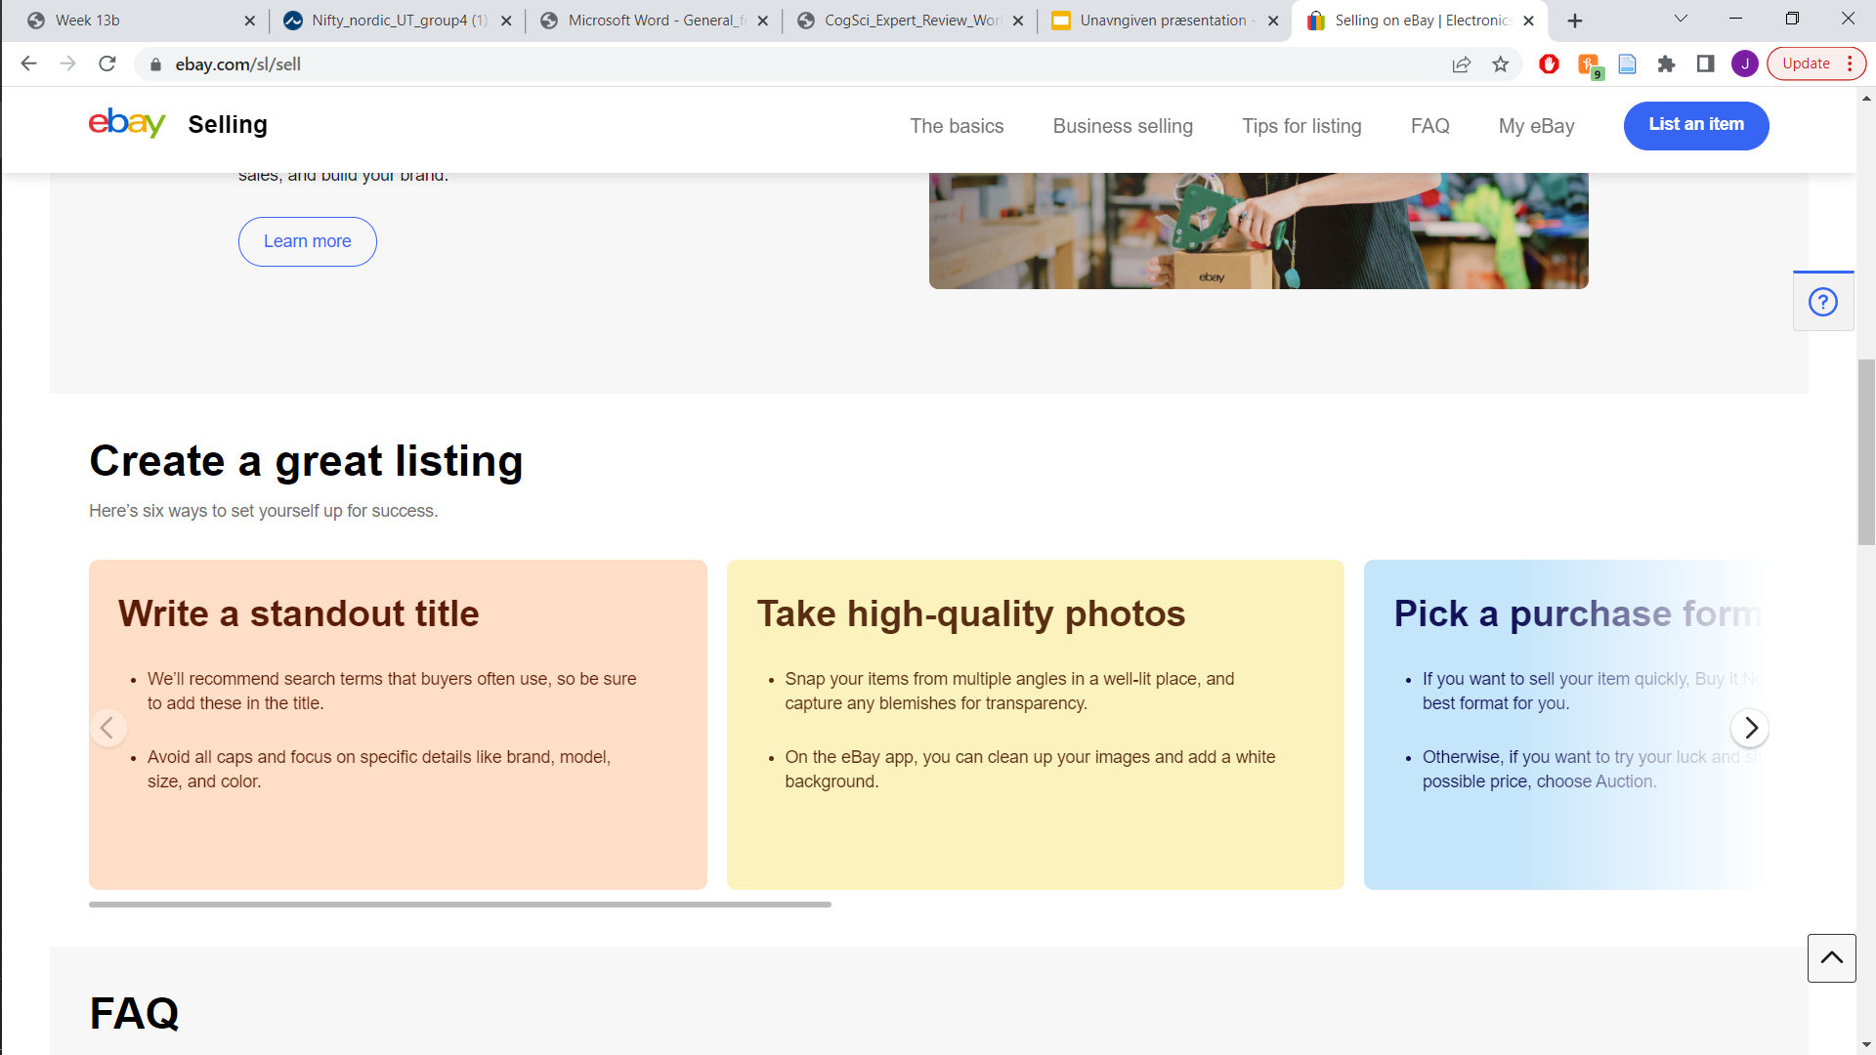
One of the current strengths of the website.
Blurring is here cleverly used to indicate that something is hidden to the right. It taking advantages of the visual systems tendency to fill in missing information, making us think that there is something to the right of the last blue box, because it is perceived as whole box and not just a blurred away box.
Furthermore, the use of redundancy to further facilitate that there is something hidden to the right without cluttering the visual hierarchy is great, as the probability of the user missing this hidden layer diminishes.
Re-design.

Slide 25
Potential usability test plan

Slide 26
Suggestion for a usability test plan.
Objectives
Can users find, inspect and buy products without issues?
Can users find and use the sell option?
Structure for possible usability test plan.
Activity. | Details.
Introduction. | Informed consent, about recording and data management. Background questions i.e., age, gender, and previous experience.
Useability test. | Introduction to the useability test. User performs the useability test without moderator intervention.
Follow-up questions. | How the task go, any difficulties? Impressions of the website in general.
Useability scales. | Rating on: Ease of use, aesthetics and would you use it again.
Knowledge-driven questions. | If they had previous knowledge, what functions have they used. Did you realize the bidding functionality?
Additional input from user. | If the user has extra things of note about their experience.

Slide 27
Task and Subtask analysis of possible useability test plan.
Tasks. | Subtasks. | Subtasks success criteria.
1) Find a laptop on the ebay.com website. Inspect it and buy it. | 1.1) Navigate to ebay.com. | Finding the right ebay i.e., “.com”.
 | 1.2) Find the laptop on the site. | Getting into the product page.
 | 1.3) Find the “about this” section. | Finding the “about this” menu.
 | 1.4) Buy the product. | Being able to make a purchase.
2) Create a sales page for a pair of shoes, with pictures. | 2.1) Find the sell option. | Clicking the sell button.
 | 2.2) Navigate the selling procedure. | Reaching the page where one adds pictures of the product.
 | 2.3) Upload pictures of product. | Uploading pictures of the product.
 | 2.4) Checking the uploaded product. | Navigating to their newly uploaded product page.

Slide 28
References.
[1] Johnson, J. (2014a). Chapter 5—Our Peripheral Vision is Poor. In J. Johnson (Ed.), Designing with the Mind in Mind (Second Edition) (pp. 49–66). Morgan Kaufmann. https://doi.org/10.1016/B978-0-12-407914-4.00005-1
[2] Johnson, J. (2014b). Chapter 6—Reading is Unnatural. In J. Johnson (Ed.), Designing with the Mind in Mind (Second Edition) (pp. 67–85). Morgan Kaufmann. https://doi.org/10.1016/B978-0-12-407914-4.00006-3
[3] Jonn Yablonski (2020). “Jakob’s Law” Laws of UX, pp. 1-12.
[4] Johnson, J. (2014). Chapter 2—Our Vision is Optimized to See Structure. In J. Johnson (Ed.), Designing with the Mind in Mind (Second Edition) (pp. 13–27). Morgan Kaufmann. https://doi.org/10.1016/B978-0-12-407914-4.00002-6
[5] Jonn Yablonski (2020). “Postel’s Law” Laws of UX, pp. 43-52.
[6] Jonn Yablonski (2020). “Tesler's Law” Laws of UX, pp. 87-96.
[7] Johnson, J. (2014). Chapter 1—Our Perception is Biased. In J. Johnson (Ed.), Designing with the Mind in Mind (Second Edition) (pp. 1–12). Morgan Kaufmann. https://doi.org/10.1016/B978-0-12-407914-4.00001-4
[8] Jakob Nielsen (2008). How Little Do Users Read? Nielsen Norman Group. Retrieved June 7, 2023, from https://www.nngroup.com/articles/how-little-do-users-read/

Slide 29
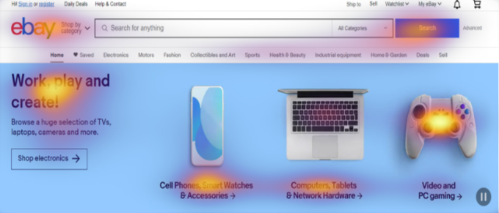
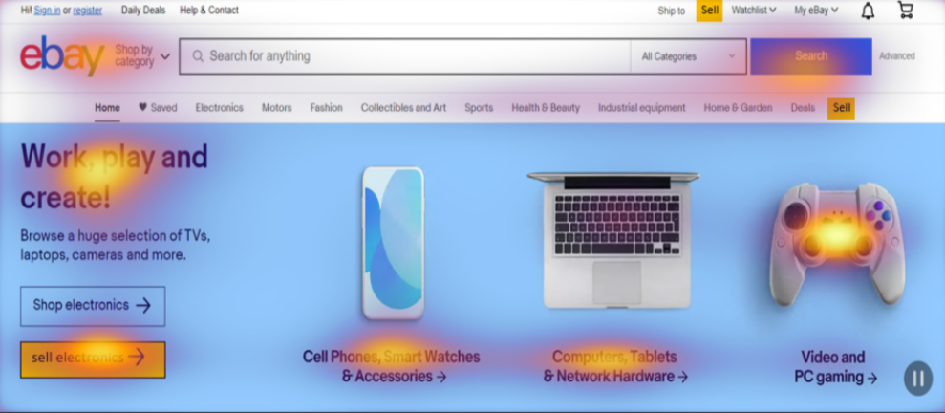
Supplementary

Slide 30
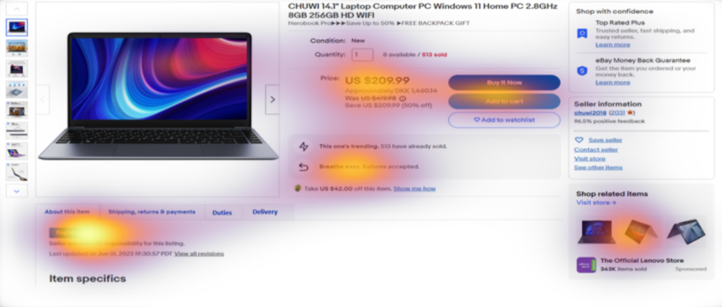
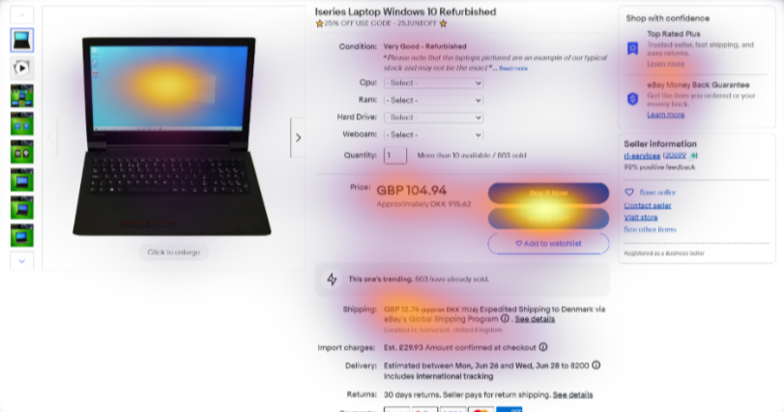
Supplementary

